Slide 1
The ecophysiological consequences of light variability
February 5, 2019

Slide 2
How does light availability to plants vary over space and time?

Slide 3
Light effects on short-term plant functioning

Slide 4
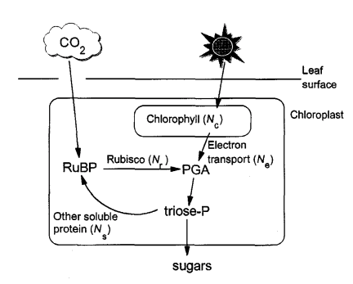
Plants use light to make energy for photosynthesis
Medlyn 1996

Slide 5
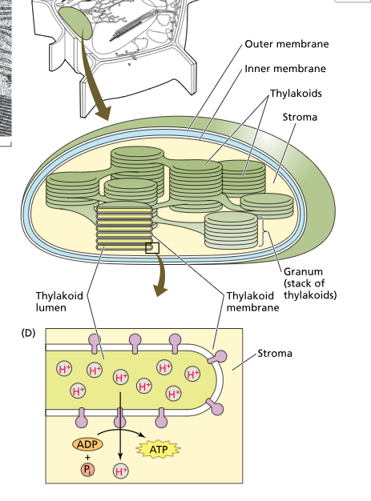
Chloroplasts
Light reaction proteins and pigments are embedded in the thylakoid membrane

Slide 6
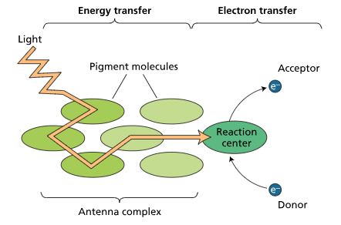
Chlorophyll
Chlorophyll pigments absorb light and create usable energy in the form of NADPH and ATP

Slide 7
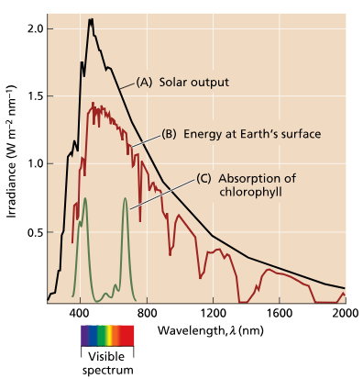
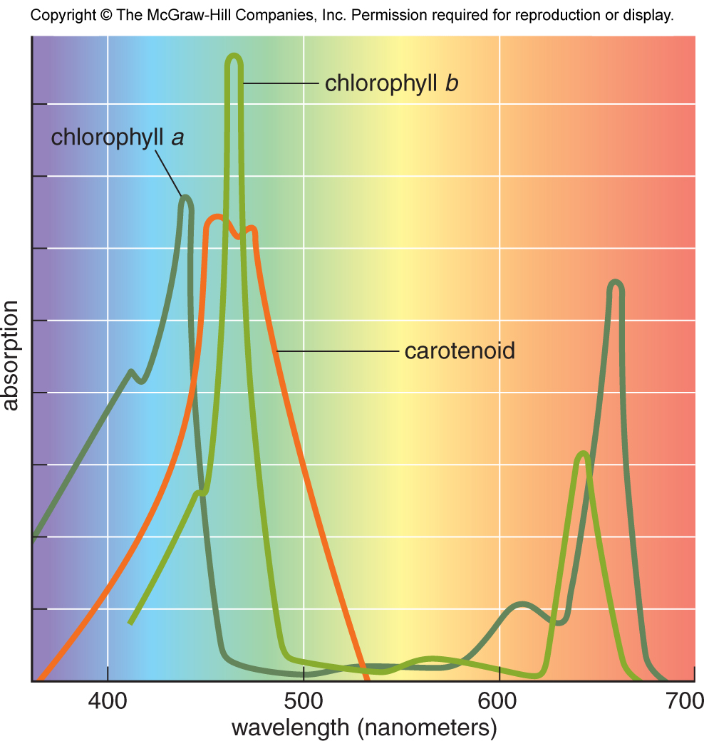

Slide 8
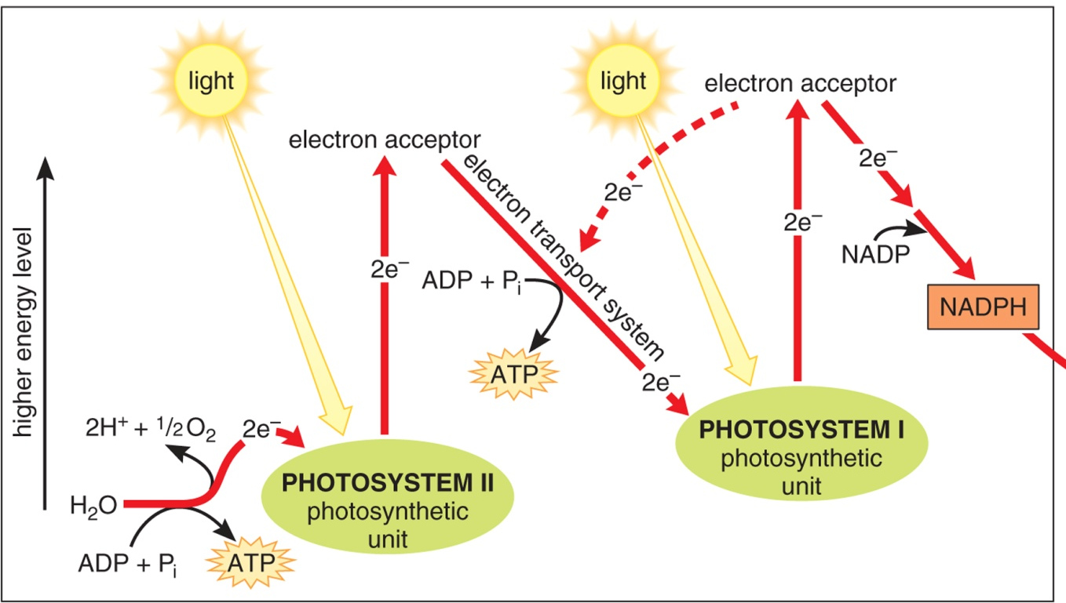
Light-dependent reactions
Ingredients
Light
H2O
NADP+
ADP
P
Outcomes
ATP
NADPH
O2
H+

Slide 9
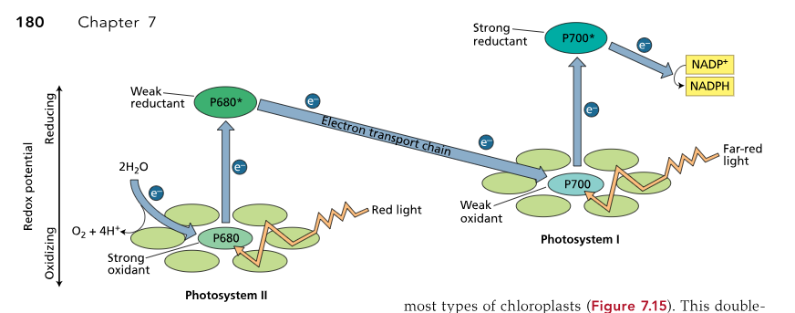
Light-dependent reactions
Ingredients
Light
H2O
NADP+
ADP
P
Outcomes
ATP
NADPH
O2
H+

Slide 10
The light response of photosynthesis

Slide 11
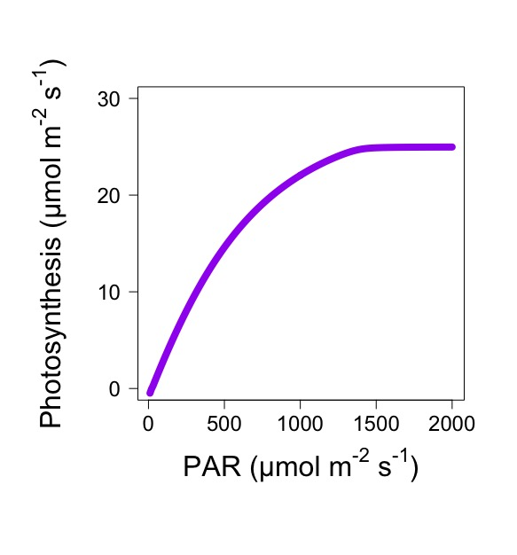

Slide 12
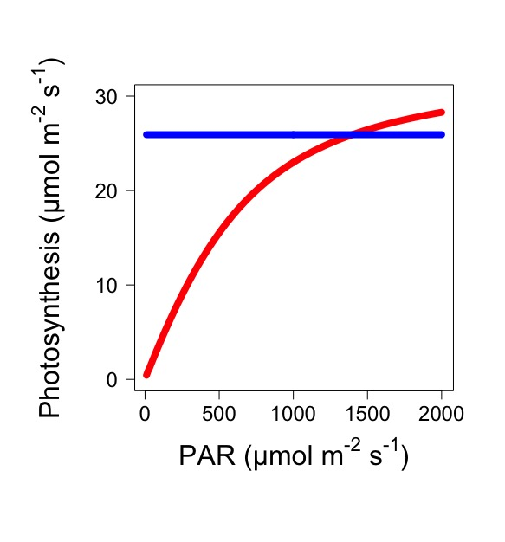
Electron transport limited
Rubisco limited

Slide 13
Light effects on long-term plant functioning - acclimation

Slide 14
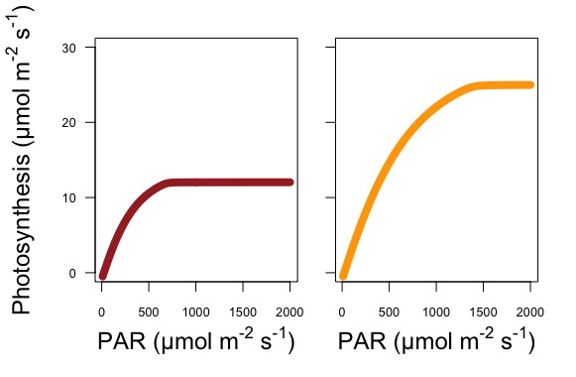
Low light acclimated
High light acclimated

Slide 15
What’s happening here?
Low light acclimated
High light acclimated

Slide 16
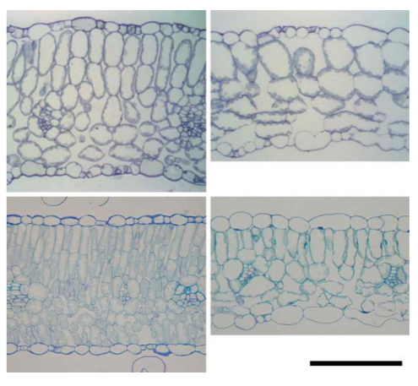
Sun leaves are thicker
Sun
Shade

Slide 17
Sun leaves are thicker – why?
Sun
Shade

Slide 18
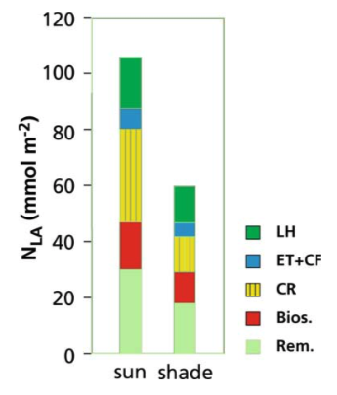
Sun leaves have more N invested in photosynthesis
Light harvesting (chlorophyll)
Electron transport
Rubisco
Biosynthesis (e.g., DNA)
Other (e.g., respiration)

Slide 19
Sun leaves have more N invested in photosynthesis – why?
Light harvesting (chlorophyll)
Electron transport
Rubisco
Biosynthesis (e.g., DNA)
Other (e.g., respiration)

Slide 20
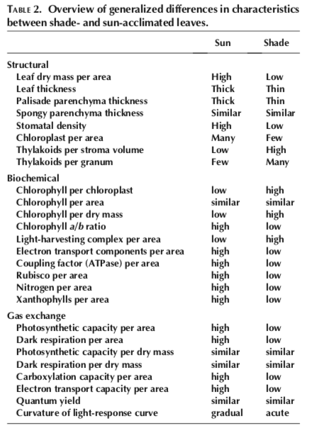
Other differences

Slide 21
Photoinhibition

Slide 22
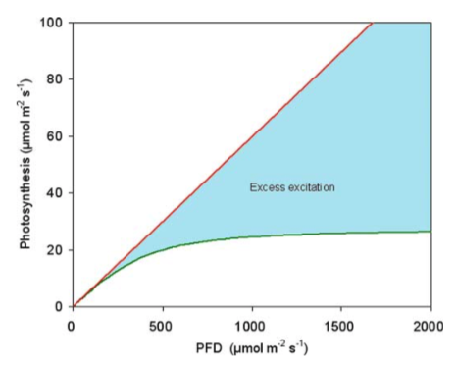
Photoinhibition
Too much excitement!

Slide 23
Photoinhibition
Excess energy is not dissipated, leading to the creating of ROS that damage photosynthetic complexes, reducing photosynthesis

Slide 24
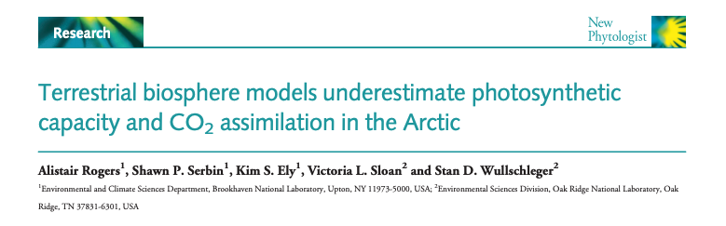
Translation: lots of Rubisco in the arctic!!
Why might this be the case?

Slide 25
How does light availability to plants vary over space and time?

Slide 26
Seasons

Slide 27
Bauerle et al. (2012)

Slide 28
Bauerle et al. (2012)

Slide 29
Sunflecks

Slide 30
Sunflecks

Slide 31
Sunflecks
Way & Pearcy (2012)

Slide 32
Light competition

Slide 33
Light is the most strongly fought-after aboveground resource

Slide 34
So why aren’t plants taller?

Slide 35
Can an individual plant be sun and shade adapted?

Slide 36
Activity: how would photosynthesis, nitrogen, and LMA differ within a plant canopy?
Develop a hypothesis to answer how each trait would change within an individual’s canopy

Slide 37
CANTRIP database
https://github.com/trevorkeenan/traitPlasticity
200 species
Data from top and bottom of canopy

